Slide 1
Search Guide

Slide 2
Why are you asking me to do an entity search in SAM?
A SAM.gov exclusions search ensures that the company or individual SAISD wants to purchase from is not excluded from receiving federal contracts or a purchase order using federal funding.

Slide 3
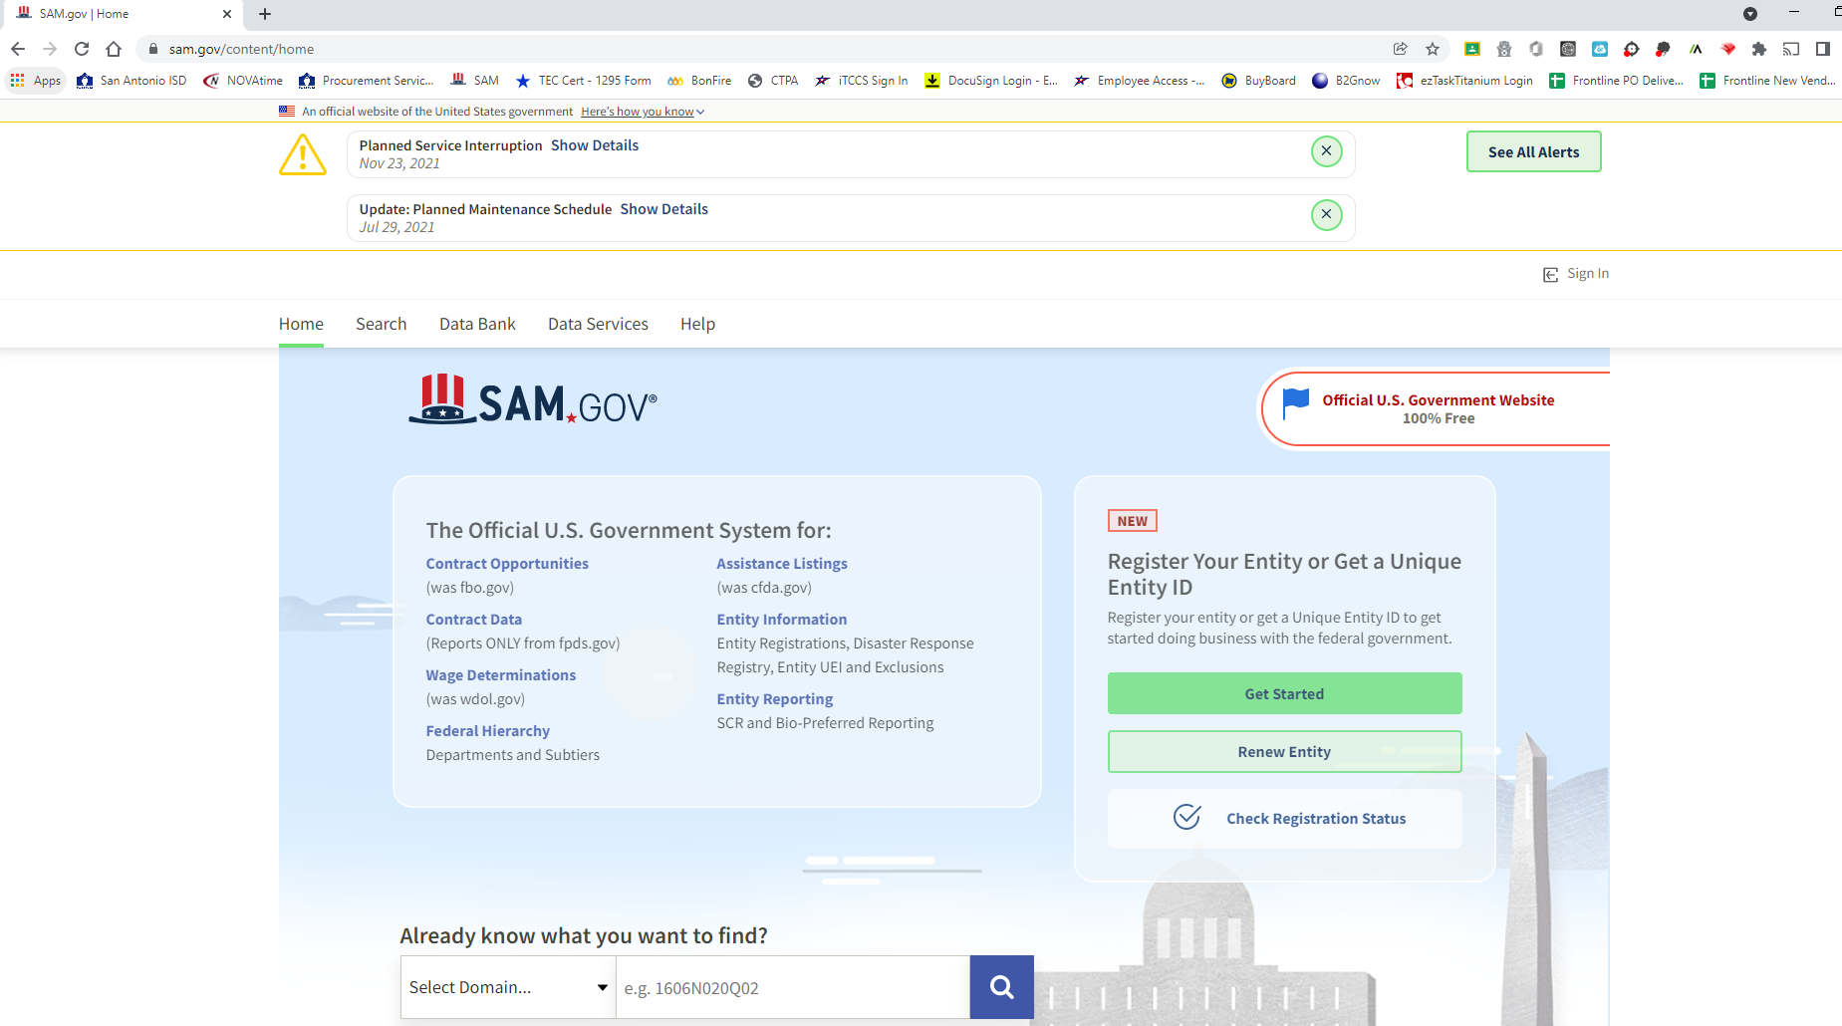
SAM.gov Home Page

Slide 4
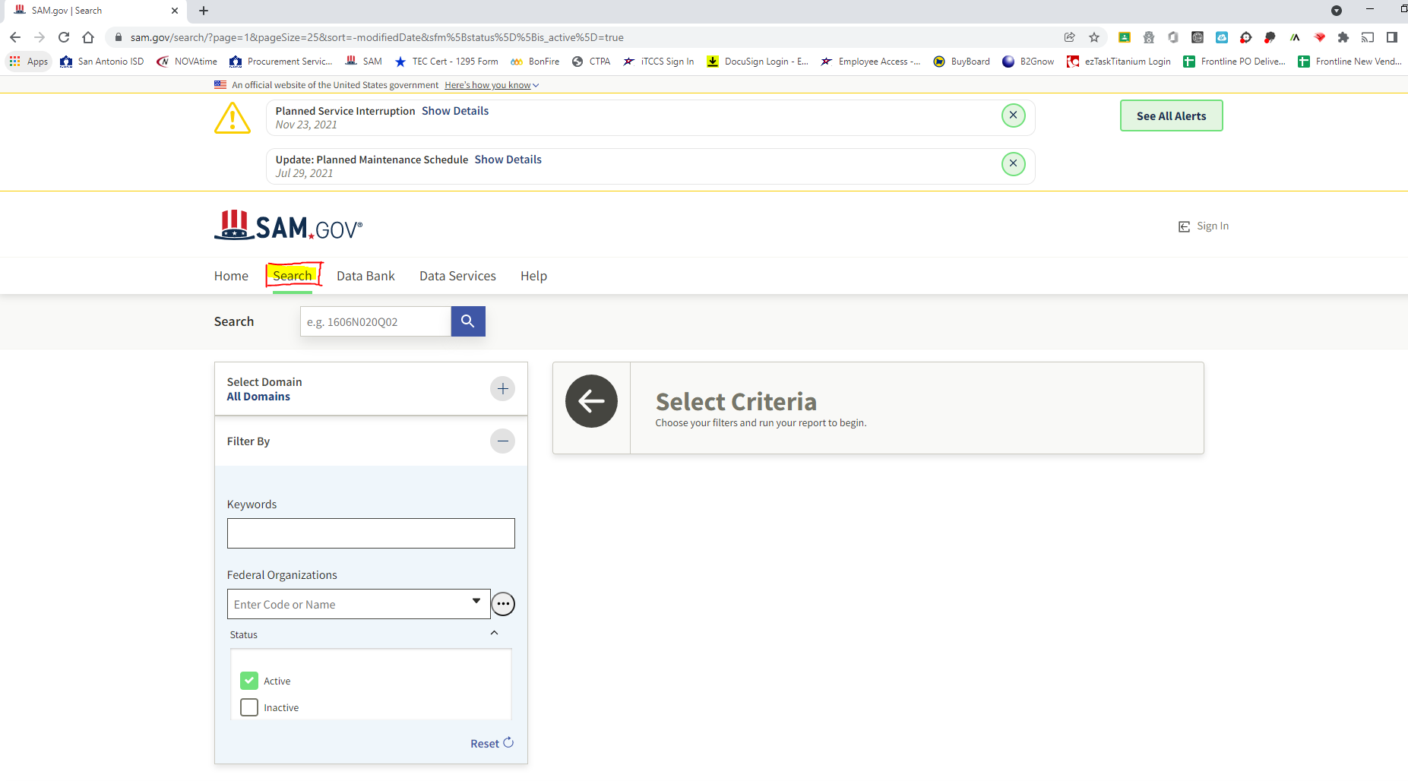
Steps to Exclusion Search
Click on the 'Search' Tab on the Home Page

Slide 5
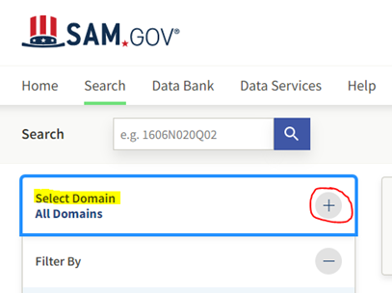
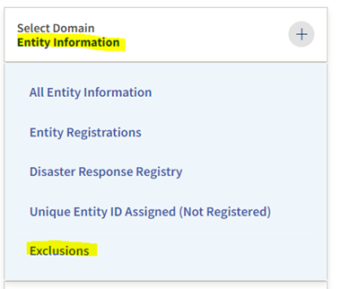
2. Click on the '+' in the "Select Domain" Field
3. Select the domain "Entity Information

Slide 6
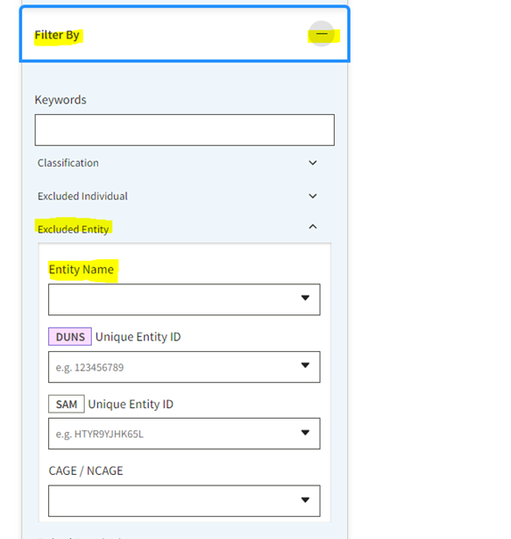
4. Click the '+' next to "Filter By"
5. Click the '^' next to "Excluded Entity"
6. Enter the Company or Individual Name

Slide 7
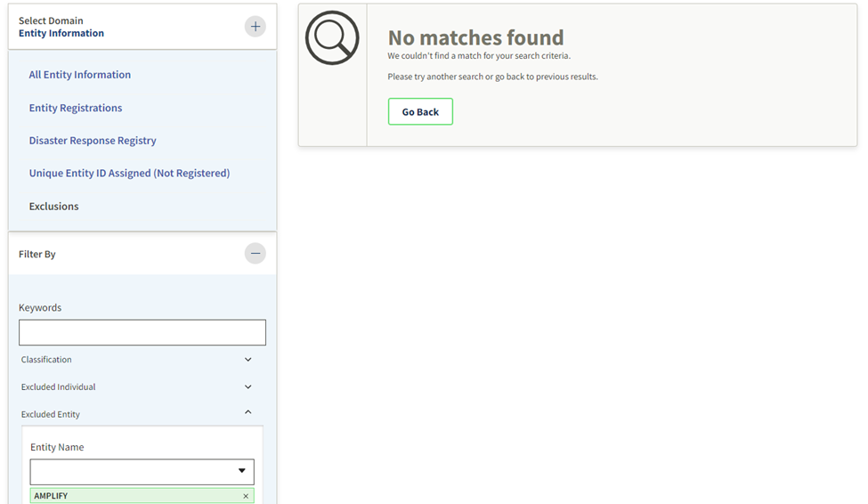
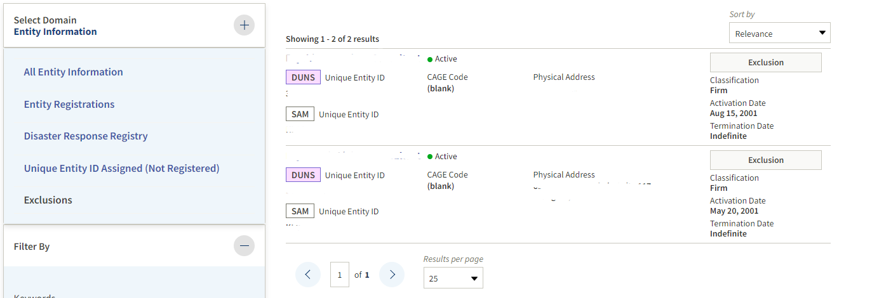
7. Print your screen
Does Not Have Exclusions
Exclusions

